Slide 1
Generative Models
Yu-Wen Chen
2018 / 04

Slide 2
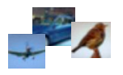
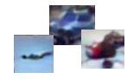
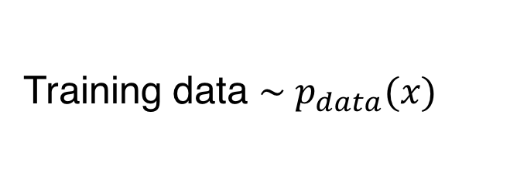
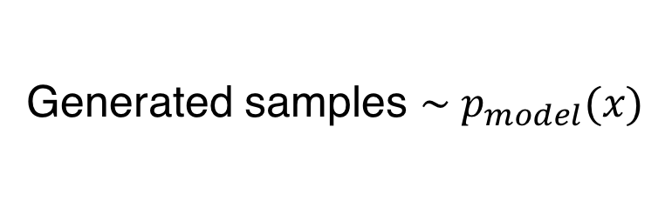

Generative Models
Given training data, generate new samples from same distribution.
Want to learn $p_{model}(x)$ similar to $p_{data}(x)$
Training data $\sim p_{data}(x)$
Generated samples $\sim p_{model}(x)$

Slide 3
Application of Generative Models
Images
image generation、image denoising、in-painting、 super-resolution
Language
chat bot、translation、speech synthesis
Learn to understand data through generation
The model need to learn the characteristic of picture
Feature step generation
intelligent agent、simulation planning

Slide 4

Taxonomy of Generative Models
Explicit density estimation: explicitly define and solve for $p_{model}\left(x\right)$
Implicit density estimation: learn model that can sample from $p_{model}\left(x\right)$w/o explicitly defining it
Generative models
Explicit density
Implicit density
GAN
Tractable density
Approximate density
PixelRNN/CNN
Variational Autoencoder

Slide 5
Outline
PixelRNN/CNN
Varitional Autoencoder (VAE)
Generative Adversarial Network (GAN)
VAE/GAN
Summary

Slide 6
PixelRNN and PixelCNN

Slide 7
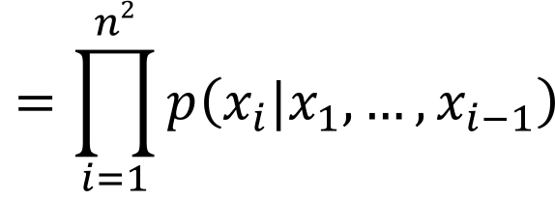

Auto-Regressive Generative Models (1)
Train a network that models the conditional distribution of every individual pixel given previous pixels
$$p\left(x\right)=p\left(x_{1}\right)p\left(x_{2}|x_{1}\right)…p\left(x_{n2}|x_{1},…,x_{n2−1}\right)$$
$$=\prod_{i=1}^{n2}{p\left(x_{i}|x_{1},…,x_{i−1}\right)}$$
Likelihood of image x
Probability of i’th pixel value given all previous pixels

Slide 8
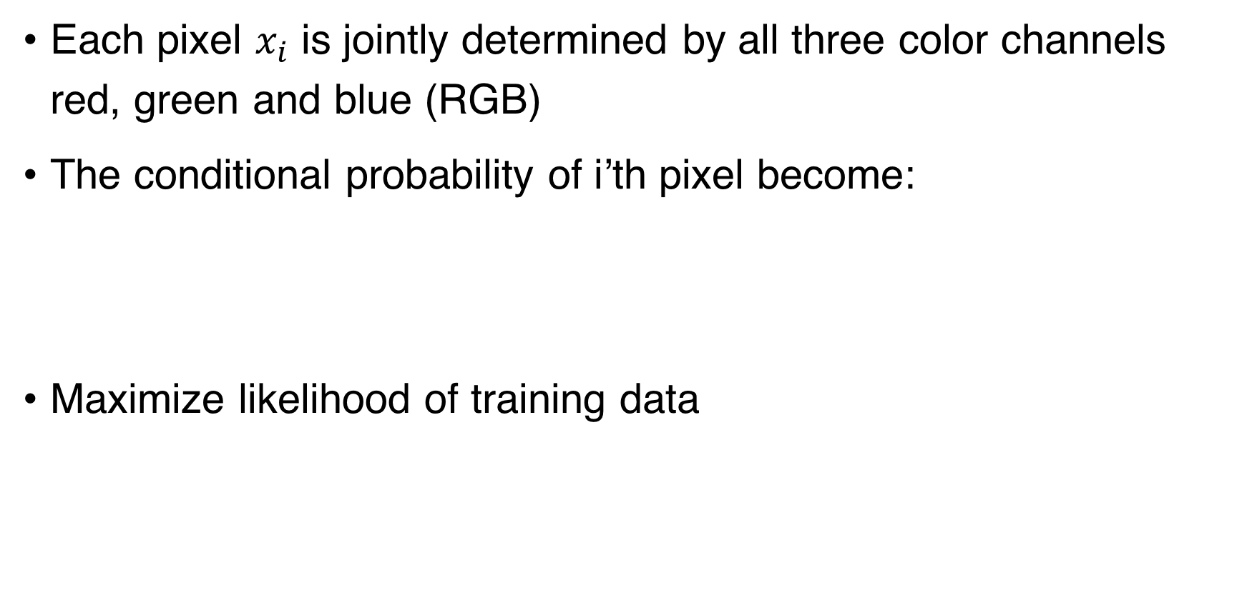

Auto-Regressive Generative Models (2)
Each pixel $x_{i}$ is jointly determined by all three color channels red, green and blue (RGB)
The conditional probability of i’th pixel become:
Maximize likelihood of training data
$$p\left(x_{i}\right)=p\left(x_{i,R}|x_{<i}\right)p\left(x_{i,G}|x_{<i},x_{i,R}\right)p\left(x_{i,B}|x_{<i},x_{i,R},x_{i,G}\right)$$

Slide 9
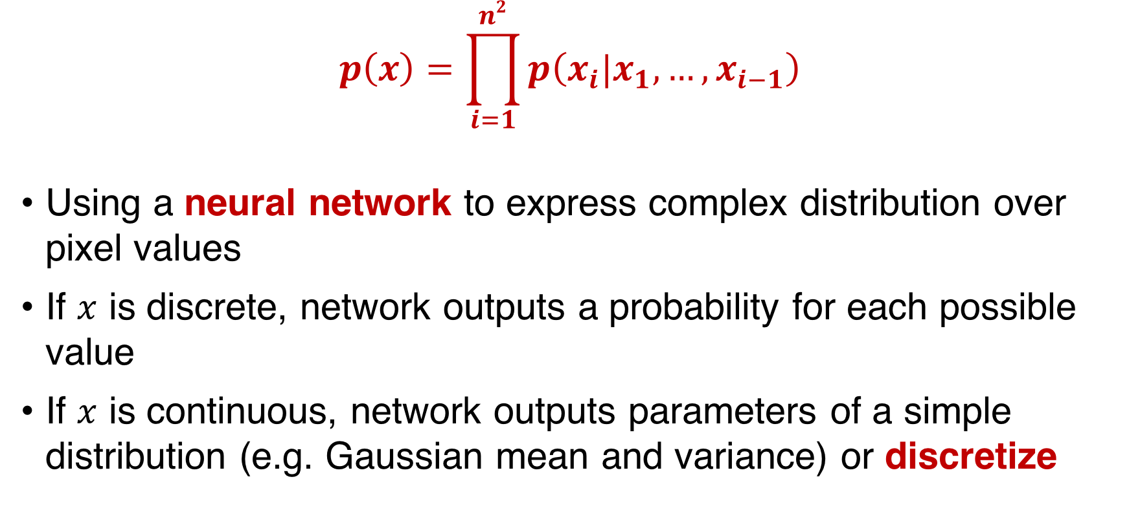
Auto-Regressive Generative Models (3)
$$p\left(x\right)=\prod_{i=1}^{n2}{p\left(x_{i}|x_{1},…,x_{i−1}\right)}$$
Using a neural network to express complex distribution over pixel values
If $x$ is discrete, network outputs a probability for each possible value
If $x$ is continuous, network outputs parameters of a simple distribution (e.g. Gaussian mean and variance) or discretize

Slide 10
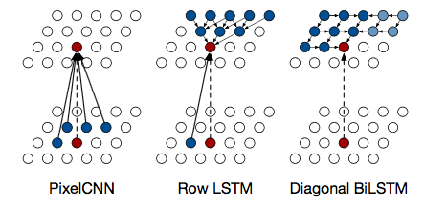
PixelRNN
Generate image pixels starting from corner
Use LSTM to model dependency of previous pixels
Generated sample
Training data

Slide 11
PixelRNN (Cont.)
Discretize each pixel to 256 possible values to improve performance
Drawback:
Sequential generation is slow
Training RNN is slow
Use CNN instead ➔ PixelCNN

Slide 12
PixelCNN
Use standard convolutional layers to capture a bounded receptive field and compute features for all pixel positions at once

Slide 13
PixelCNN (Cont.)
Training is faster than PixelRNN
Can parallelize convolutions since context region values known from training images
Generation still slow because it must still proceed sequentially
Perform worse than PixelRNN:
The convolutional layers are unable to completely process the receptive fields thus leading to a slight miscalculation of pixel values.

Slide 14
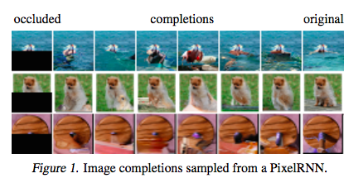
Experiment Results

Slide 15
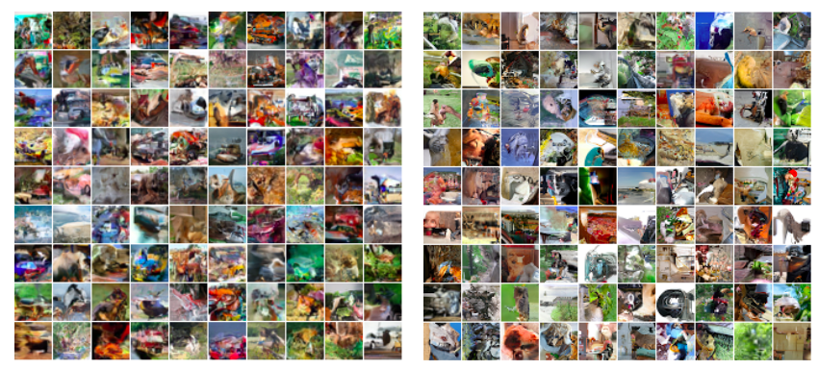
Experiment Results
Diagonal BiLSTM
32x32 CIFAR-10
32x32 ImageNet

Slide 16
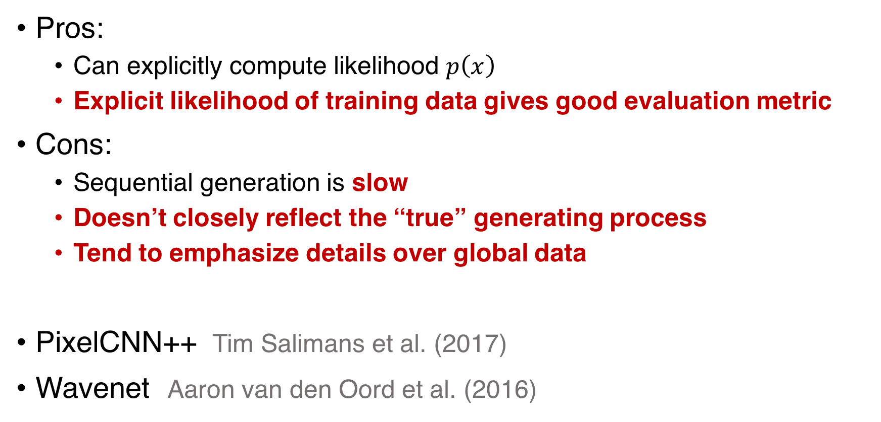
Summary
Pros:
Can explicitly compute likelihood $p\left(x\right)$
Explicit likelihood of training data gives good evaluation metric
Cons:
Sequential generation is slow
Doesn’t closely reflect the “true” generating process
Tend to emphasize details over global data
PixelCNN++ Tim Salimans et al. (2017)
Wavenet Aaron van den Oord et al. (2016)

Slide 17
Variational Autoencoder (VAE)

Slide 18
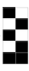
Autoencoder
Generator
Randomly generate a vector as code
?
Decoder
New image
Notes:
Think of zooming an image or reducing the bit rate of a mp3 file, that’s what you get.

Slide 19


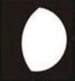
Autoencoder (Cont.)
Why not use autoencoder to generate new images ?
Generated images will look similar to original training data but of poorer quality
?
Decode
Decode
Z
Z
Encode
Encode

Slide 20
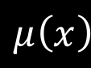

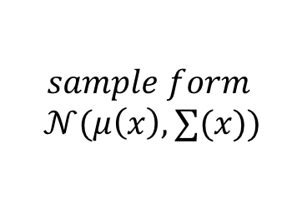

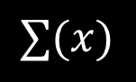

Variational Autoencoder (VAE)
$$\hat{x}$$
decoder
Decode
$$z$$
$$sample form$$
$$𝒩(μ\left(x\right),∑(x))$$
Z
x
Encode
$$μ\left(x\right)$$
$$∑(x)$$
encoder
$$x$$

Slide 21




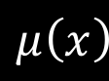





Loss Function of VAE
Loss function $l_{i}$ for datapoint $x_{i}$:
$$l_{i}\left(θ,φ\right)=−E_{z\sim q_{θ}\left(z | x_{i}\right)}\left[logp_{φ}\left(x_{i} | z\right)\right]+KL(q_{θ}\left(z | x_{i}\right)|\left|p(z)\right)$$
Parameters
of NN
Reconstruction loss
(The same as autoencoder)
Regularizer
$$μ\left(x\right)$$
$$x$$
encoder
$$θ$$
$$z$$
decoder
$$p_{φ}\left(x | z\right)$$
$$\hat{x}$$
$$∑(x)$$
$$sample form$$
$$𝒩(μ\left(x\right),∑(x))$$
encoder
$$q_{θ}\left(z | x\right)$$

Slide 22
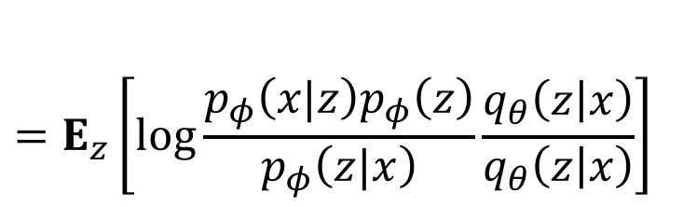
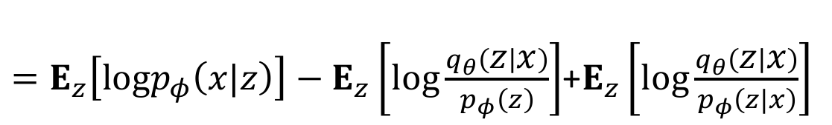

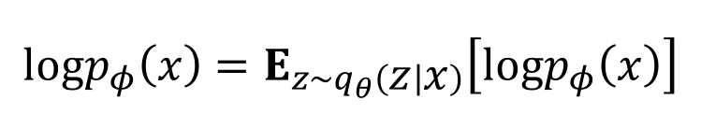
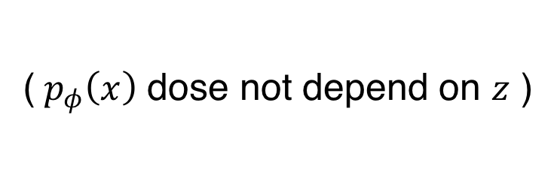
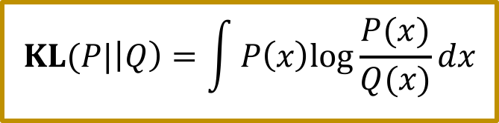
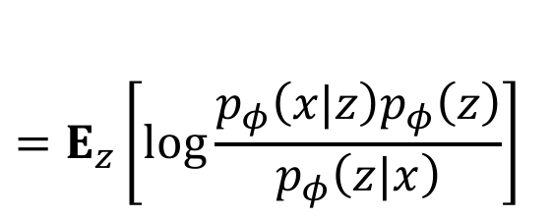
Maximum Likelihood (1)
$$logp_{φ}\left(x\right)=E_{z\sim q_{θ}\left(z | x\right)}\left[logp_{φ}\left(x\right)\right]$$
($p_{φ}\left(x\right)$ dose not depend on $z$ )
$$=E_{z}\left[log\frac{p_{φ}\left(x|z\right)p_{φ}\left(z\right)}{p_{φ}\left(z|x\right)}\right]$$
(Bayes’ Rule)
$$=E_{z}\left[log\frac{p_{φ}\left(x|z\right)p_{φ}\left(z\right)}{p_{φ}\left(z|x\right)}\frac{q_{θ}\left(z | x\right)}{q_{θ}\left(z | x\right)}\right]$$
$$KL(P|\left|Q\right)=\int{P\left(x\right)log\frac{P(x)}{Q(x)}dx}$$
$=E_{z}\left[logp_{φ}\left(x|z\right)\right]−E_{z}\left[log\frac{q_{θ}\left(z | x\right)}{p_{φ}\left(z\right)}\right]$+$E_{z}\left[log\frac{q_{θ}\left(z | x\right)}{p_{φ}\left(z|x\right)}\right]$
$$=E_{z}\left[logp_{φ}\left(x|z\right)\right]−KL(q_{θ}\left(z | x\right)||p_{φ}\left(z\right))+KL(q_{θ}\left(z | x\right)||p_{φ}\left(z|x\right))$$

Slide 23


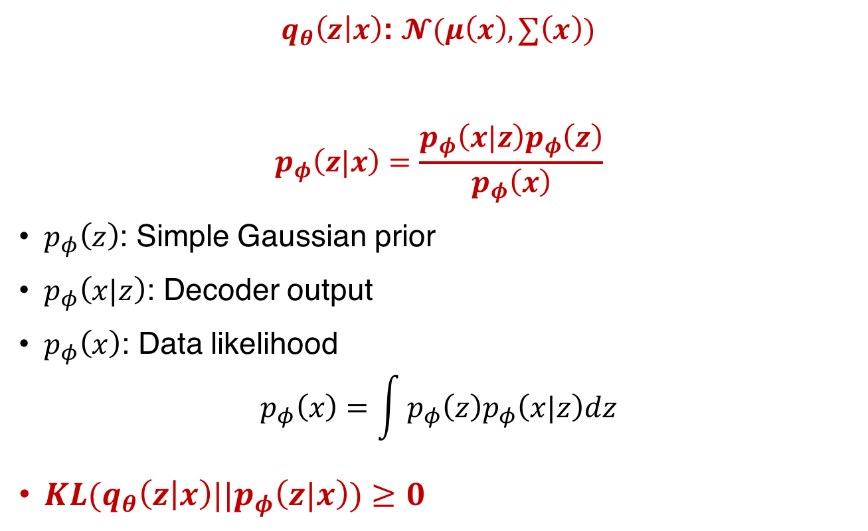

Maximum Likelihood (2)
$logp_{φ}\left(x\right)$ $=E_{z}\left[logp_{φ}\left(x|z\right)\right]−KL(q_{θ}\left(z | x\right)||p_{φ}\left(z\right))+KL(q_{θ}\left(z | x\right)||p_{φ}\left(z|x\right))$
$q_{θ}\left(z | x\right)$: $𝓝(μ\left(x\right),∑\left(x\right))$
$$p_{φ}\left(z|x\right)=\frac{p_{φ}\left(x|z\right)p_{φ}\left(z\right)}{p_{φ}\left(x\right)}$$
$p_{φ}\left(z\right)$: Simple Gaussian prior
$p_{φ}\left(x|z\right)$: Decoder output
$p_{φ}\left(x\right)$: Data likelihood
$$p_{φ}\left(x\right)=\int{p_{φ}\left(z\right)p_{φ}\left(x|z\right)dz}$$
$KL(q_{θ}\left(z | x\right)||p_{φ}\left(z|x\right))≥0$
Gaussian Mixtures, $μ\left(x\right),∑\left(x\right)$ learned from encoder network
( Need to be evaluated over all configurations of latent variables )
Intractable

Slide 24

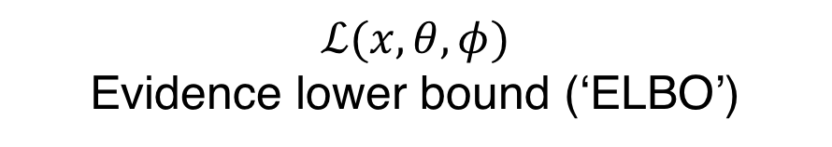
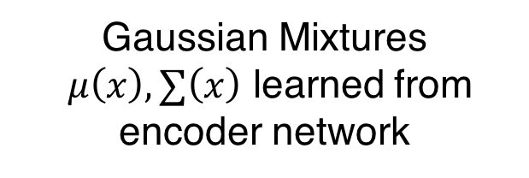


Maximum Likelihood (3)
$logp_{φ}\left(x\right)$ $=E_{z}\left[logp_{φ}\left(x|z\right)\right]−KL(q_{θ}\left(z | x\right)||p_{φ}\left(z\right))+KL(q_{θ}\left(z | x\right)||p_{φ}\left(z|x\right))$
$logp_{φ}\left(x\right)$ $≥ E_{z}\left[logp_{φ}\left(x|z\right)\right]−KL(q_{θ}\left(z | x\right)||p_{φ}\left(z\right))$
$E_{z}\left[logp_{φ}\left(x|z\right)\right]$
$KL(q_{θ}\left(z | x\right)||p_{φ}\left(z\right))$: has closed-form solution
$$≥0$$
$$ℒ(x,θ,φ)$$
Evidence lower bound (‘ELBO’)
Gaussian Mixtures
$μ\left(x\right),∑\left(x\right)$ learned from encoder network
Simple Gaussian prior

Slide 25
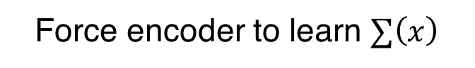
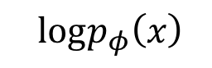
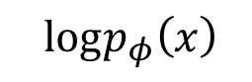
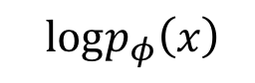

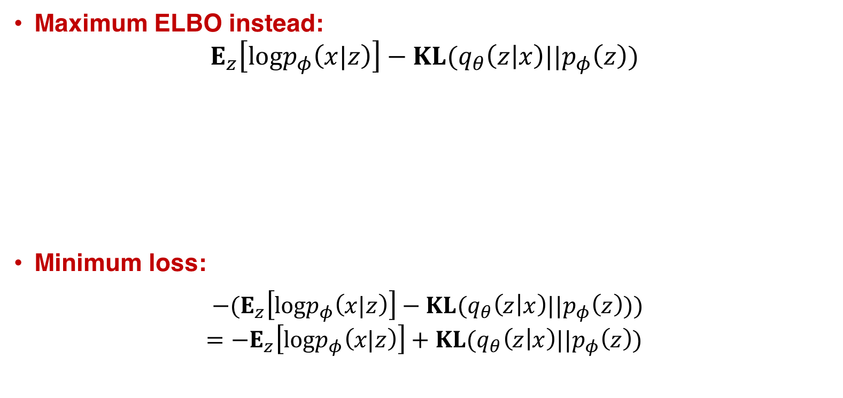
Maximum Likelihood (4)
$logp_{φ}\left(x\right)$ $=E_{z}\left[logp_{φ}\left(x|z\right)\right]−KL(q_{θ}\left(z | x\right)||p_{φ}\left(z\right))+KL(q_{θ}\left(z | x\right)||p_{φ}\left(z|x\right))$
Maximum ELBO instead:
$$E_{z}\left[logp_{φ}\left(x|z\right)\right]−KL(q_{θ}\left(z | x\right)||p_{φ}\left(z\right))$$
Minimum loss:
$−(E_{z}\left[logp_{φ}\left(x|z\right)\right]−KL(q_{θ}\left(z | x\right)||p_{φ}\left(z\right)))$
$$=−E_{z}\left[logp_{φ}\left(x|z\right)\right]+KL(q_{θ}\left(z | x\right)||p_{φ}\left(z\right))$$
KL=0
KL
KL
$logp_{φ}\left(x\right)$
$logp_{φ}\left(x\right)$
$logp_{φ}\left(x\right)$
ELBO
ELBO
ELBO
Force encoder to learn $∑\left(x\right)$

Slide 26
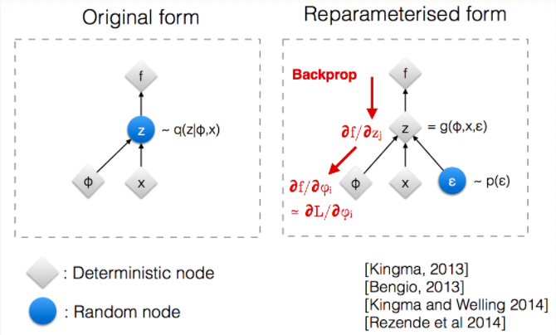

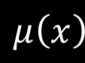




Reparameterization Trick
$$\hat{x}$$
decoder
$$z$$
$$sample form$$
$$𝒩(μ\left(x\right),∑(x))$$
x
$$μ\left(x\right)$$
$$∑(x)$$
ϵ∼Normal(0,I)
encoder
$$x$$

Slide 27


Experiment Results (1)
Vary z₂
Vary z₁

Slide 28

Experiment Results (2)

Slide 29
Generative Adversarial Network (GAN)

Slide 30
GAN
Notes:
$$\min_{G}{\max_{D}{V\left(D,G\right)=Ε_{x\sim p_{data}\left(x\right)}\left[logD\left(x\right)\right]+Ε_{z\sim p_{z}\left(z\right)}\left[log⁡(1−D(G(z)))\right]}}$$

Slide 31

VAE/GAN
The Encoder learns to map input x onto z space (latent space)
The Generator learns to generate x from z space
The Discriminator learns to discriminate whether the image being put in is real, or generated

Slide 32

VAE/GAN
Train Encoder on minimization of:
kullback_leibler_loss(z_x, gaussian)
mean_squared_error(l_x_tilde_, l_x)

Slide 33
VAE/GAN
Train Generator on minimization of:
kullback_leibler_loss(z_x, gaussian)
mean_squared_error(l_x_tilde_, l_x)
-1*log(d_x_p)

Slide 34
VAE/GAN
Train Discriminator on minimization of:
-1*log(d_x) + log(1 - d_x_p)

Slide 35

Experiment Results of VAE/GAN

Slide 36
Summary

Slide 37

Recap
Explicit density estimation
PixelRNN/CNN
Optimize exact likelihood: $p\left(x\right)=\prod_{i=1}^{n2}{p\left(x_{i}|x_{1},…,x_{i−1}\right)}$
VAE
Optimize variational lower bound: $E_{z}\left[logp_{φ}\left(x|z\right)\right]−KL(q_{θ}\left(z | x\right)||p_{φ}\left(z\right))$
Implicit density estimation
GAN
Game-theoretic approach (Two player game)

Slide 38
Comparison of different Methods
 | PixelCNN/RNN | VAE | GAN
Training curve |  |  | Unstable(Tricky)
Time required to generate new image | Long
Quality | Lack of global structure | Blurrier, lower quality | State-of-the-art
Data type | Discrete / continuous data (discrete is slightly better) | Discrete / continuous data | Continuous data (unless, in theory, use REINFORCE)

Slide 39
References (1)
Course
CS231n: Convolutional Neural Networks for Visual Recognition Spring 2017:
https://www.youtube.com/watch?v=5WoItGTWV54&t=4165s
ML Lecture 17: Unsupervised Learning - Deep Generative Model:
https://www.youtube.com/watch?v=YNUek8ioAJk&list=PLJV_el3uVTsPy9oCRY30oBPNLCo89yu49&index=26
https://www.youtube.com/watch?v=8zomhgKrsmQ&list=PLJV_el3uVTsPy9oCRY30oBPNLCo89yu49&index=27
Blog
VAE tutorial:
https://jaan.io/what-is-variational-autoencoder-vae-tutorial/
Varitional inferences:
http://www.openias.org/variational-coin-toss

Slide 40
References (2)
Implementation:
VAE keras implementation:
https://blog.keras.io/building-autoencoders-in-keras.html
VAE/GAN implementation:
https://github.com/timsainb/Tensorflow-MultiGPU-VAE-GAN
Paper list:
PixelRNN/CNN: Pixel Recurrent Neural Networks Aa ̈ron van den Oord et al. (2016)
VAE: Auto-Encoding Variational Bayes Diederik P. Kingma et al. (2014)
GAN: Generative Adversarial Networks Ian J. Goodfellow et al.(2014)
VAE/GAN: Autoencoding beyond pixels using a learned similarity metric
Anders Boesen Lindbo Larsen et al. (2016)

